Slide 1
DigEco Logo
P 8
618270-EPP-1-2020-1-LT-EPPKA2-CBHE-JP
Digitalization of economic as an element of sustainable development
of Ukraine and Tajikistan / DigEco
DMYTRO MOTORNYI TAVRIA STATE AGROTECNOLOGICAL UNIVERSITY
(TSATU)
This project has been funded with support from the European Commission. This presentation reflects the views only of the author, and the Commission cannot be held responsible for any use which may be made of the information contained there in.

Slide 2
TOP3 in Ukrainian Agricultural Universities
TSAU was established in 1932.
Our mission is to provide the higher education for the modern specialist.
The University has received various State Awards and Honors.
Our scientific results are recognized in the World.
TSAU includes 4 faculties, 6 research and education institutes, 6 colleges and a research farm.
The faculties provide diplomas in 21 specialties/
TSAU provides practice-oriented education.

Slide 3
Strengths developed infrastructure of education maintenance and high quality scientific staff
Staff
The united team of professors in numerous specialties (more than 40 professors of D.Sc );
Collaboration with Universities both in Ukraine and abroad (Bulgaria, Poland, Israel, Hungary, Kazakhstan, China);
Practice-oriented staff, which has experience of work in various companies;
The university has wide range of facilities: more than 100 research and study well-equipped laboratories with digital facilities, 27 rooms with computers, a farm, a first-aid post;
more than 500 thousand copies of printed and electronic publications are stored in the library’s funds;
Available equipment for distance education;
Equipment & Resources

Slide 4
Strengths curriculum and syllabuses are based on staff’s practical experience, students requests and collaboration with International programs
Relevance
Participation in Melitopol Development strategy and International programs of Azov Sea region development;
Consulting and expertizing of entrepreneurs in agribusiness to get a competitive position on the External and Internal market;
TSAU provides professional trainings for young entrepreneurs, women and militaries;
Innovative teaching methods (case-studies, business games, imitation games, laboratory research, field-trips, field days);
The flexible list of numerous selective courses which covers soft and hard skills in agriculture and business;
Different approaches to education (distance and dual education, individual plans)
Courses

Slide 5
Weaknesses deficient supply of contemporary educational equipment and software for students with disabilities
Staff
Low level of academic mobility opportunities for young faculties and students;
Insufficient level of staff skills in usage of professional modern software, that require time and efforts for re-training;
Workload of operational tasks and academic requirements;
Permanent aging equipment and appearance of novel one make to be engaged in life-learning process;
Insufficient equipment and software supply for disabled people limit their opportunity to enter the University;
Expensive professional equipment to make electronic courses and educational platforms;
-
-
Equipment & Resources

Slide 6
Weaknesses low level of commercialization of research results and lack of relevant digital courses
Relevance
Entrepreneurs are not ready to pay competitive prices for market analysis and scientific research;
Lack of database of current issues in agricultural business in the region;
Insufficient integration: university – business – government;
Some courses are not effective because of usage of outdated software;
Only few courses meet the needs of disabled people or taught in English;
Courses on educational platform are more electronic than digitalized
-
Courses

Slide 7
Opportunities digitalization of educational process and collaboration with local government
Political
Support by the Ministry of Education and Science and the Committee for Digital Transformation of Ukraine in digitalization of the initial process at universities;
Collaboration between universities and local government (region, city and united territorial communities);
Participation in various state programs directed to entrepreneurship development of women, youth, militaries and villagers;
Attracting investments from international funds and entrepreneurs;
Developing of the new courses based on labor market needs in bilingual staff
Enhancing of volume chain of goods with help of digitalization of management process;
Collaboration with other co-funded universities do develop a new market direction;
Economic

Slide 8
Opportunities implementation of modern technologies and professional software for digitalization of the educational process
Technological
Application of modern Internet technologies, cloud systems, and professional software to develop new courses;
Training of staff and faculties to use new software and approaches to work with disabled people using it;
Developing of a joint platform with University partners to organize conferences, on-line courses and round-tables;
Further implementation of courses for social groups (women, youth, militaries and disable people);
Enhancing the position of alumni at a labor market;
Partnership with numerous association to share new professional skills;
Social

Slide 9
Threats insufficient state financial support of the university to update education equipment
Political
Imperfect legal framework for the development of distance education and for paid system of consulting and other educational services such as trainings;
Politian risks in changing of rules to provide a state financial support for Universities;
Complication of requirements of government-supported entry to Universities;
The financial and economic crisis in the country, which leads to a decrease in the solvency of the population and business;
Probable reduction in funding for regional projects due to the influence of economic issues;
Quickly changing business environment leads to new challenges in economic analysis and requires usage of various digital software
Economic

Slide 10
Threats low level of students skills in usage of digital technologies and limited knowledge of foreign languages
Technological
The availability of online education services might lead to outflow of students to more prestigious universities;
implementation of full distance learning might not allow to exploit the equipment of the university to obtain practical skills;
complexity of tender purchases of equipment in Ukraine;
accessibility and preference for European education
low level of knowledge of usage digital technologies and foreign languages at a high school
poor Internet coverage in rural areas
complexity of employment of disabled people
Social

Slide 11
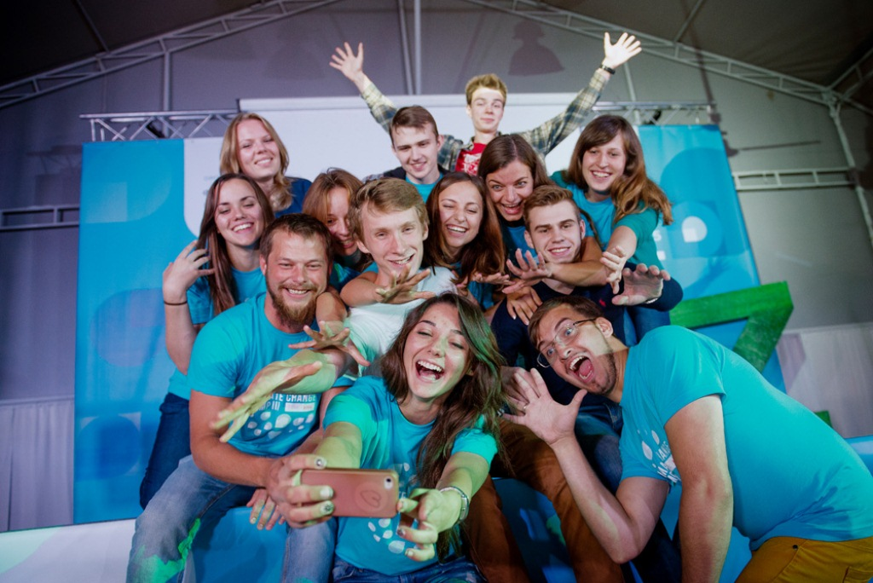
Thank you for your attention!!!
Contacts
Rector
Volodymyr Kurchev
D.Sc., Professor, Corresponding Member of NAASU
office@tsatu.edu.ua
Contact person (Head of the Marketing Department)
Darya Legeza
D.Sc., Professor
darya.legeza@tsatu.edu.ua

