Slide 1
Ministry of Science and Education of Ukraine
Dmytro Motornyi Tavria State Agrotechnological University
Department of Foreign Languages
Theme of the report:
English as a Global Language
…,
student of group 11 MC
Melitopol, 2019

Slide 2
Let’s discuss today:
Language Statistics
Reasons
to Learn English
Curious Facts
about English

Slide 3
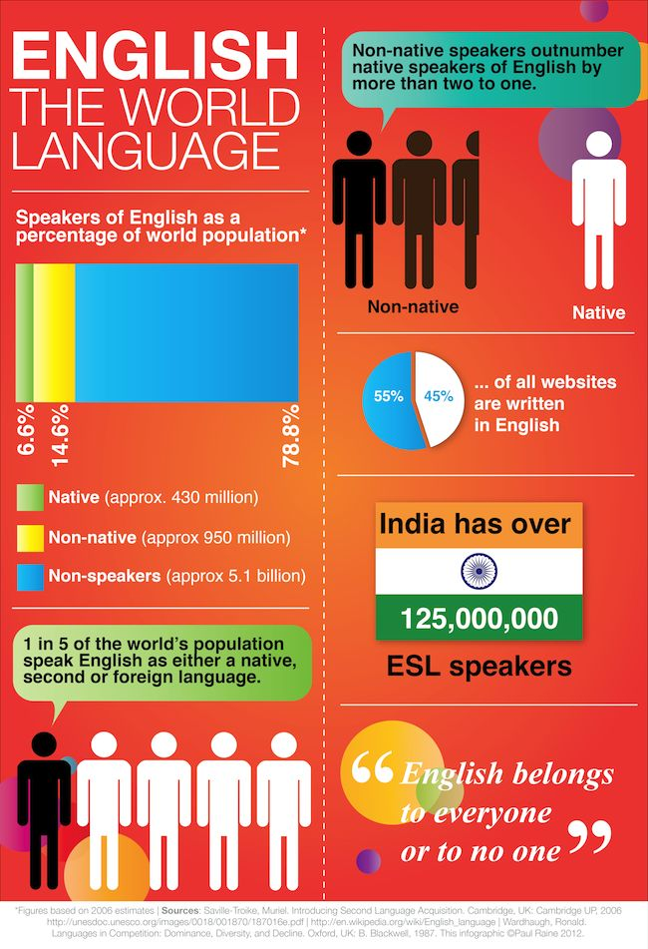
Language Statistics

Slide 4
Reasons to learn English #1
English is the most commonly spoken language in the world.
Knowing English increases your chances of getting a good job in a multinational company.
English is the official language of 53 countries.
English is the language of the media industry.

Slide 5
Reasons to learn English #2
English is also the language of the Internet.
English is based on a simple alphabet and it is fairly quick and easy to learn compared to other languages.
If you speak English, there’re lots of opportunities for you to find a course to suit your academic needs.
By learning English, you will also learn about other cultures.

Slide 6
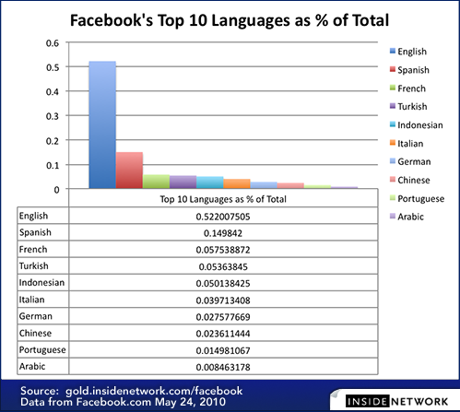
Reasons to learn English #3

Slide 7
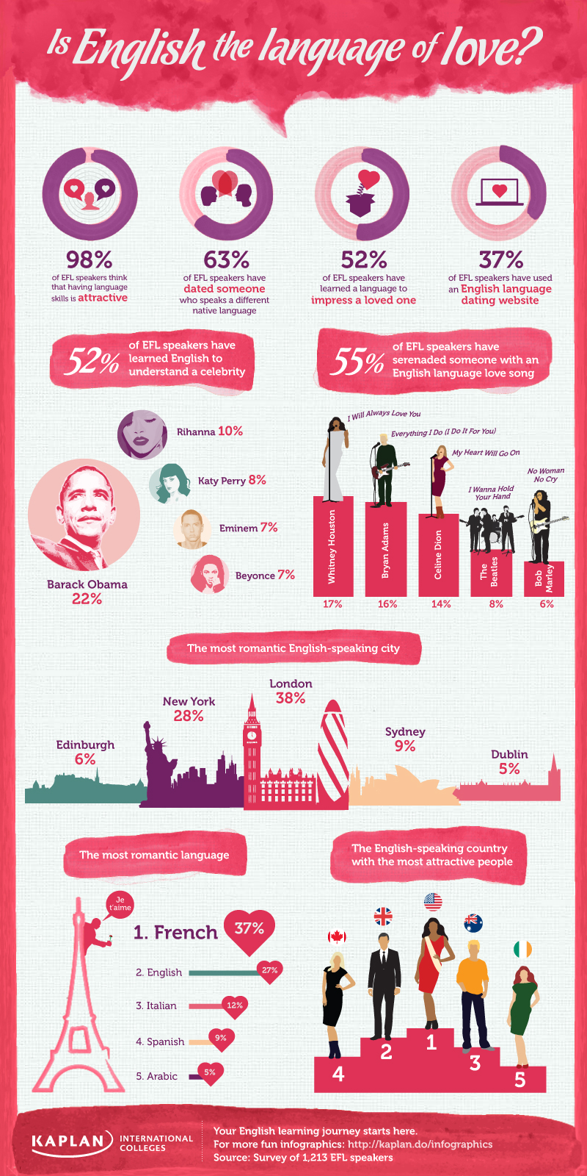
Reasons to learn English #4

Slide 8
Curious facts about English #1
English actually originates from what is now called north west Germany and the Netherlands.
About 4,000 words are added to the dictionary each year.
The US doesn’t have an official language.
90% of English text consists of just 1000 words.
There are 24 different dialects of English in the US.

Slide 9
Curious facts about English #2
11% of the entire English language is just the letter E.
The oldest English word that is still in use is ‘town’.
The most common adjective used in English is ‘good’.
The most commonly used noun is ‘time’.
The word ‘set’ has the highest number of definitions.

Slide 10
Curious facts about English #3
The original name for butterfly was flutterby.
The word ‘happy’ is used 3 times more often than the word ‘sad’!
Month, orange, silver and purple do not rhyme with any other word.
Etymologically, Great Britain means ‘great land of the tattooed’.
‘Awful’ used to mean ‘inspiring wonder’ and ‘nice’ used to mean ‘silly’

Slide 11
References:
Fun Facts about English Language [Електронний ресурс] / lingoda.com: – Режим доступу:
https://www.lingoda.com/en/blog/fun-facts-english-language (Дата звернення: 10.09.2017).
10 Reasons to Learn English [Електронний ресурс] / experienceenglish.com: – Режим доступу:
http://www.experienceenglish.com/social-english/articles/10-reasons-learn-english (Дата звернення: 10.09.2017).

Slide 12
Thank you for your attention!

Slide 13
The Report Text
Today I am going to present you the main reasons to learn English and to better your command of the foreign language [1].
The theme of my report is ‘English as a Global Language’.
My presentation will focus on [2]:
Language Statistics
Reasons to learn English
Curious facts about English
Firstly, I’d like to present data on language usage [3].
On this slide you see the infographic about English speaking part of world population. As you see, 20% of world population speak English.
The next 2 slides represent main reasons to learn English according to the worldwide Internet survey [4, 5].
Let’s familiarize ourselves with them:
1. Everybody knows, English is the most commonly spoken language in the world because 11out of 5 people can speak or at least understand English!
2. English is the language of science, of aviation, computers, diplomacy, and tourism. Knowing English increases your chances of getting a good job in a multinational company within your home country or of finding work abroad.
3. English is the official language of 53 countries. That is a lot of people to meet and speak to.
4. English is the language of the media industry. If you speak English, you won’t need to rely on translations and subtitles anymore to enjoy your favourite books, songs, films and TV shows.
6. English is also the language of the Internet. Many websites are written in English – you will be able to understand them and to take part in forums and discussions.
7. English is based on a simple alphabet and it is fairly quick and easy to learn compared to other languages.
8. Since English is spoken in so many different countries there are thousands of schools around the world that offer programs in English. If you speak English, there’re lots of opportunities for you to find an appropriate school and course to suit your academic needs.
10. It’s fun! By learning English, you will also learn about other cultures. Few experiences will make you grow as a person more than learning the values, habits and way of life in a culture that is different from yours.
Speaking of Internet, the next slide shows you Facebook statistics – join social media and better your English [6].
Slide 7 contains funny statistics about personal reasons to learn English, for example, you could sing an English song to your lover or send a message to your favourite celebrity! [7]
Slides 8 to 10 introduce curious facts about English, its history and present. Did you know that…[8, 9 10]
English actually originates from what is now called north west Germany and the Netherlands.
The original name for butterfly was flutterby.
About 4,000 words are added to the dictionary each year.
11% of the entire English language is just the letter E.
The English language is said to be one of the happiest languages in the world - oh, and the word ‘happy’ is used 3 times more often than the word ‘sad’!
The US doesn’t have an official language.
The most common adjective used in English is ‘good’.
The most commonly used noun is ‘time’.
The word ‘set’ has the highest number of definitions.
Month, orange, silver, and purple do not rhyme with any other word.
90% of English text consist of just 1000 words.
There are 24 different dialects of English in the US.
Etymologically, Great Britain means ‘great land of the tattooed’.
Many English words have changed their meaning over time - for example, ‘awful’ used to mean ‘inspiring wonder’ and was a short version of ‘full of awe’, whereas ‘nice’ used to mean ‘silly’
The oldest English word that is still in use is ‘town’.
I am sure that learning any foreign language makes a person better, but English gives you a lot of opportunities – in personal, academic or scientific spheres.
You can find out more about English on the websites lingoda.com and experienceenglish.com [11].
Thank you for your attention! [12]

